Slide 1

Revolutionising B.Tech

Slide 2
Topics covered:
Instruction Codes
Memory Reference Instructions
RISC, CISC

Slide 3
Instruction Codes:
An instruction code is a group of bits that instruct the computer to perform a specific operation.
It is usually divided into parts, each having its own particular interpretation. The most basic part of an instruction code is its operation part.
The operation code of an instruction is a group of bits that define such operations as add, subtract, multiply, shift, and complement.
Instruction 1: AND R1, R2
Instruction 2: ADD #5, #4
Opcode for ADD: Assuming opcode 0010 for ADD (4 bits)
Immediate Value 1 (#5): 5 in binary is 0101 (4 bits)
Immediate Value 2 (#4): 4 in binary is 0100 (4 bits)
Binary representation: 0010 0101 0100

Slide 4
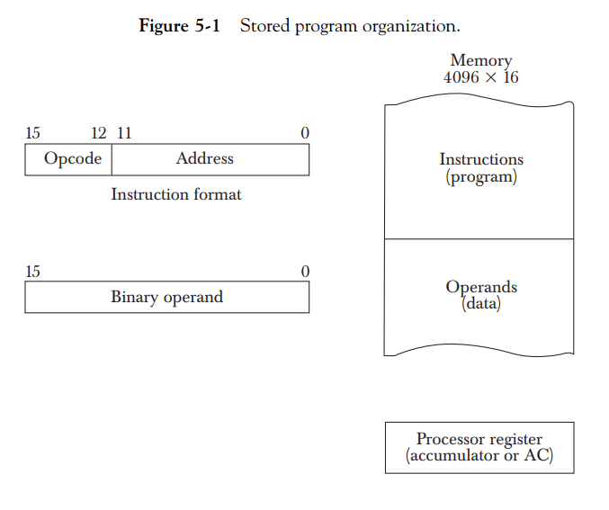

Slide 5
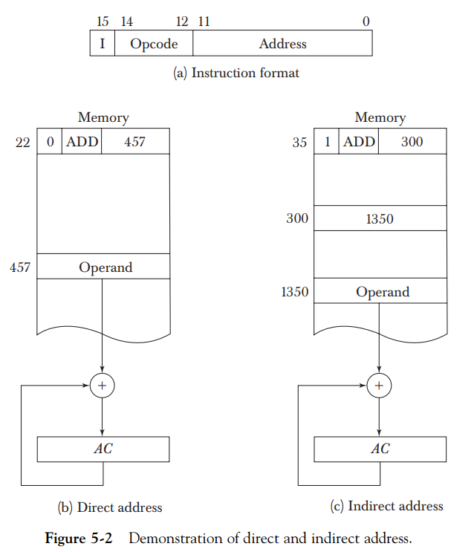

Slide 6
Memory Reference Instructions:
Memory reference instructions are a category of instructions in computer architecture that allow the processor to access and manipulate data stored in memory.
These instructions facilitate the transfer of data between memory and registers, enabling data processing operations.
Examples of load instructions: LD (load), LDR (load register), LDA (load address).
Examples of store instructions: ST (store), STR (store register).

Slide 7
Memory Reference Instructions: Contnd…
Load instructions:
Load instructions are used to retrieve data from memory and store it in registers.
They typically specify the memory address from which to load the data and the destination register to store the data.
Load instructions are commonly used to fetch operands for subsequent arithmetic or logical operations.
Store instructions:
Store instructions are used to write data from registers to memory.
They specify the source register containing the data to be stored and the memory address where the data should be written.
Store instructions are often used to store results of computations or data values in memory.

Slide 8
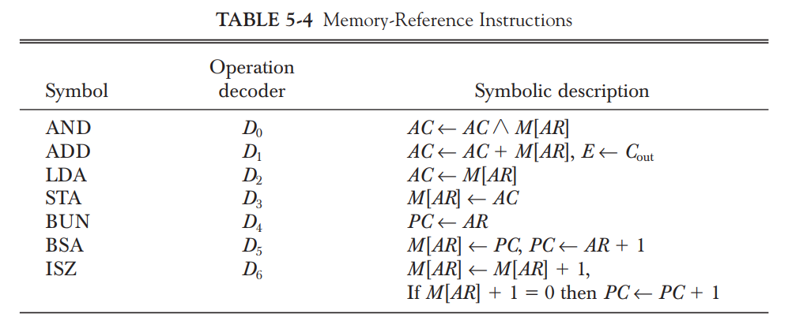
Memory Reference Instructions: Contnd…
Memory addressing modes:
Memory reference instructions support various addressing modes to specify the location of data in memory.
Direct addressing mode: The memory address is explicitly specified in the instruction.
Indirect addressing mode: The memory address is stored in a register, and the instruction refers to that register to access the data.
Indexed addressing mode: The memory address is obtained by adding an offset value to a base address stored in a register.
Immediate addressing mode: The data itself is included in the instruction as an immediate value.

Slide 9
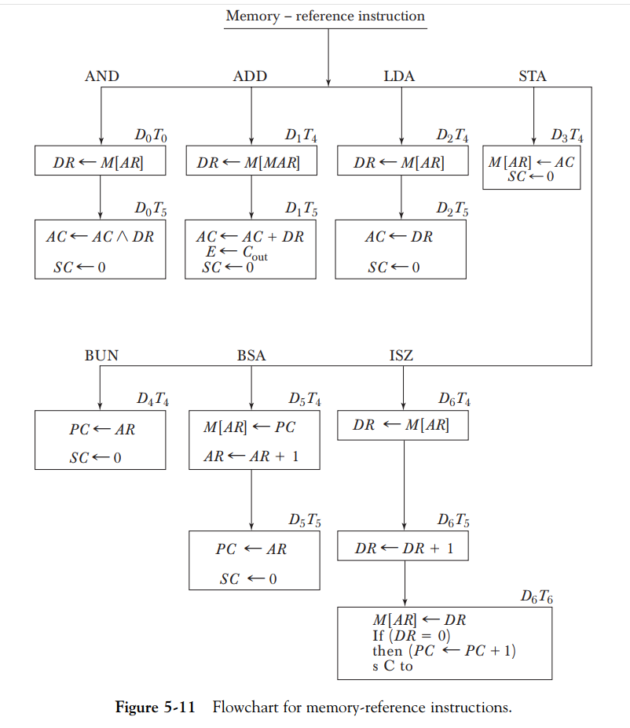

Slide 10
CISC Definition:
CISC stands for Complex Instruction Set Computer.
It is a type of computer architecture that emphasizes a large set of complex instructions.
The instructions in CISC processors are capable of performing multiple low-level operations in a single instruction.

Slide 11
Characteristics of CISC architecture:
Large instruction set: CISC processors have a wide variety of complex instructions, each capable of performing multiple operations.
Variable instruction length: Instructions in CISC architectures can have variable lengths, ranging from a few bytes to several bytes.
Memory-to-memory operations: CISC instructions often allow direct memory-to-memory operations, reducing the need for explicit load and store instructions.
Emphasis on hardware: CISC architectures tend to rely heavily on specialized hardware to implement complex instructions efficiently.
Implicit operands: CISC instructions often have implicit operands, which are not explicitly specified in the instruction but are implied by the instruction itself.

Slide 12
Advantages of CISC architecture:
Compact code size: CISC instructions can perform multiple operations, reducing the number of instructions required to accomplish a task, resulting in compact code.
High-level language support: CISC architectures are designed to support high-level programming languages and their complex constructs directly.
Reduced memory accesses: CISC instructions can access memory directly, reducing the number of explicit load and store instructions required.
Simplified programming: With a large set of complex instructions, CISC architectures simplify programming tasks by providing more powerful instructions.

Slide 13
Disadvantages of CISC architecture:
Complexity: The complex nature of CISC instructions makes the design and implementation of CISC processors more challenging.
Longer instruction execution time: The execution time for complex instructions in CISC architectures is generally longer compared to simpler instructions found in RISC architectures.
Hardware complexity: Supporting a large set of complex instructions requires complex hardware, which can increase the cost and power consumption of the processor.
Reduced pipelining efficiency: The complex and variable-length instructions in CISC architectures make instruction pipelining less efficient, limiting the potential for high-performance execution.

Slide 14
Examples of CISC architectures:
Intel x86 architecture: The x86 architecture, used in most personal computers, is a prominent example of a CISC architecture.
Motorola 68000 series: The 68000 series of processors, used in early Macintosh computers, is another well-known CISC architecture.
DEC VAX architecture: The VAX architecture, developed by Digital Equipment Corporation, was a widely used CISC architecture in the 1970s and 1980s.

Slide 15
RISC Definition:
RISC stands for Reduced Instruction Set Computer.
It is a type of computer architecture that emphasizes a simplified and streamlined set of instructions.
RISC processors typically have a smaller number of instructions, each performing a simple and well-defined operation.

Slide 16
Characteristics of RISC architecture:
Simple and fixed instruction format: RISC architectures use a simplified instruction format, often with a fixed length, making instruction fetching and decoding more efficient.
Fewer instructions: RISC processors have a reduced instruction set, focusing on the most commonly used operations and avoiding complex and specialized instructions.
Load/store architecture: RISC architectures utilize a load/store architecture, where data must be explicitly loaded from memory into registers for operations and stored back to memory afterward.
Register-based operations: RISC architectures heavily rely on registers for performing operations, minimizing memory accesses.
Pipelining support: RISC processors are designed to be easily pipelined, dividing the instruction execution process into multiple stages to increase overall performance.
Compiler-driven optimizations: RISC architectures rely on compilers to optimize code and make efficient use of available registers and instructions.

Slide 17
Advantages of RISC architecture:
Improved performance: The simplified and streamlined instructions of RISC architectures allow for faster instruction execution and higher overall performance.
Reduced complexity: RISC processors have simpler hardware designs compared to Complex Instruction Set Computers (CISC), making them easier to design, implement, and manufacture.
Lower power consumption: The simplicity of RISC architectures often leads to lower power consumption compared to CISC architectures.
Efficient compiler optimization: RISC architectures facilitate compiler-driven optimizations, enabling the generation of efficient code to take advantage of the available registers and instruction pipeline.
Scalability: RISC architectures are highly scalable, allowing for easy expansion and integration of additional processing units.

Slide 18
Disadvantages of RISC architecture:
Increased memory access: RISC architectures rely heavily on memory access due to their focus on register-based operations. This can result in increased memory traffic and potential performance bottlenecks.
Larger code size: RISC instructions are simplified and perform basic operations, which can result in more instructions needed to accomplish a complex task. This can lead to larger code size and increased memory usage.
Lack of specialized instructions: RISC architectures typically avoid specialized and complex instructions found in CISC architectures. While this simplifies the hardware design, it may require more instructions to accomplish certain tasks, impacting performance and code efficiency.
Limited instruction flexibility: RISC architectures have a limited set of instructions, which may not cover all possible operations required by certain applications. This can require more instructions and additional computational steps to achieve the desired functionality.

Slide 19
Examples of RISC architectures:
ARM: ARM processors, commonly found in mobile devices, tablets, and embedded systems, are based on the RISC architecture.
MIPS: MIPS (Microprocessor without Interlocked Pipeline Stages) processors have been widely used in various applications, including consumer electronics and networking devices.
PowerPC: PowerPC processors, developed by IBM, Motorola, and Apple, were based on the RISC architecture and were utilized in a range of computing systems.
SPARC: SPARC (Scalable Processor Architecture) processors, developed by Sun Microsystems, were based on the RISC architecture and were used in their workstation and server systems.

Slide 20
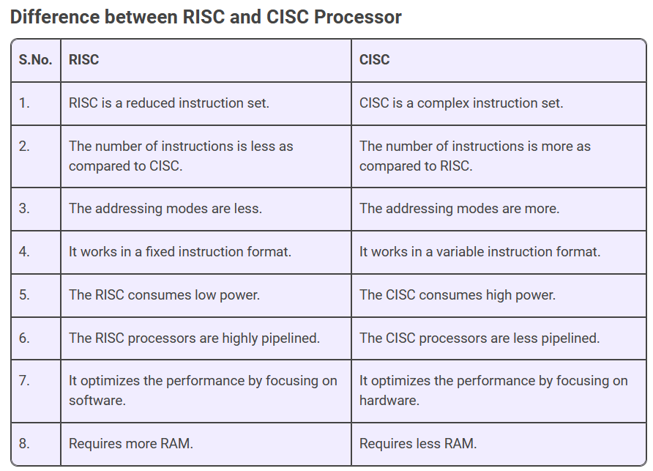

Slide 21
Thank you

